Slide 1
Comparison of Parallel Programming Frameworks
By:
Omkar Deshmukh
Shiva Prashant Chada

Slide 2
Agenda
Introduction and related work
Methodology
Performance Comparison
Tool chain and Ecosystem
Conclusion and future work

Slide 3
Introduction and related work
Related works:
“Performance Gaps between OpenMP and OpenCL for Multi-core CPUs” (Jie Shen et al.)
“A Comprehensive Performance Comparison of Cuda and OpenCL “ (Jianbin Fang er al.)
Types of parallel computing platforms
Our Work:
Single Core : Vectorization with SSE/AVX
Multi Core: OpenMP
Multi Core: OpenCL and Vectorization with OpenCL
GPU: NVIDIA CUDA

Slide 4
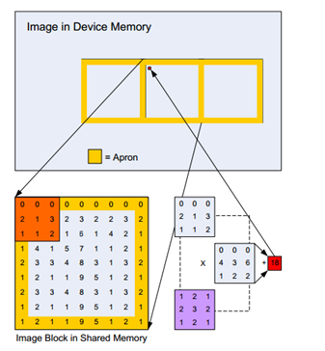
Methodology
2D Image Convolution Kernel.
2 types of scaling analysis-
Scaling image dimension:
increased memory requirements
4K to 16K elements image width
Fixed filter width of 16 elements
Scaling Kernel dimensions
Increased arithmetic intensity
4 to 24 elements filter width
Fixed image width of 8K elements
(CUDA code does not have kernel scaling cases)
Compared single threaded CPU execution time against parallel implementation
Used codes from AMD and NVIDIA SDKs
For SSE/AVX modified AMD code to incorporate intrinsics.
For OpenMP no change in code
For CUDA 2 versions tested
Non-separable kernel (our implementations)
Separable kernel Cuda SDK

Slide 5
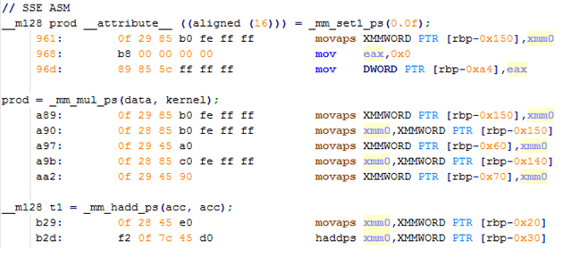
SSE / AVX
Use of intrinsics
Memory aligned accesses
Temporary variables aligned
Global variables unaligned
Flow:
Packing elements into vector
Packed multiply and add
Unpacking and reduction

Slide 6
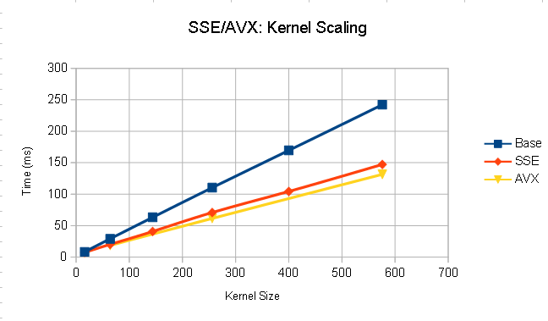
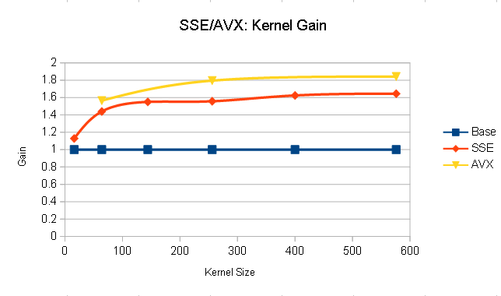

Slide 7
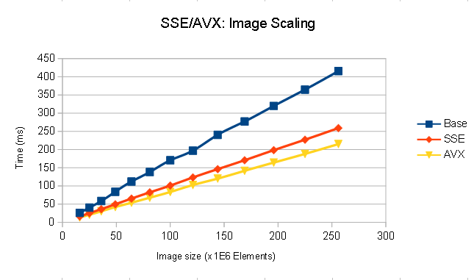
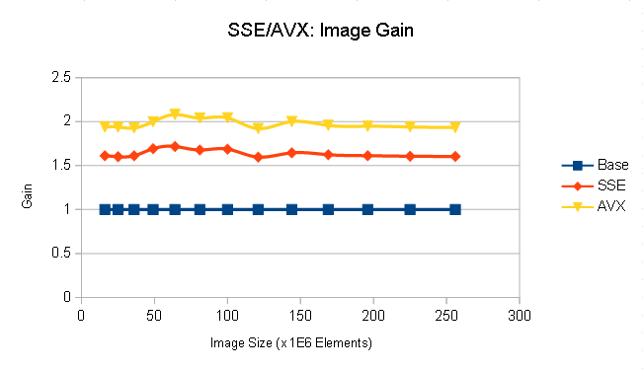

Slide 8
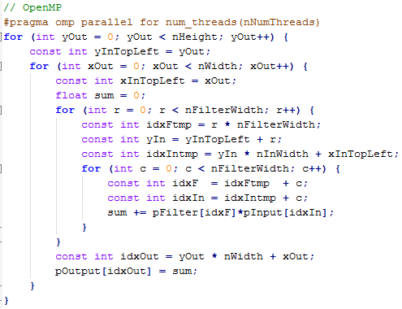
OpenMP
Directives based parallelization.
Test runs with 4, 16 and 64 Threads on single AMD node.

Slide 9
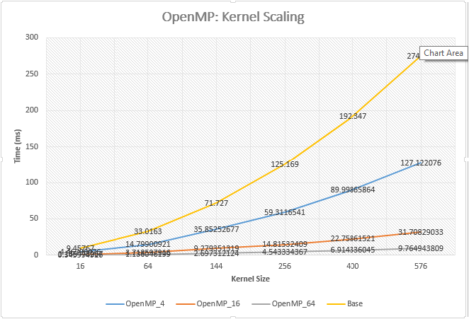
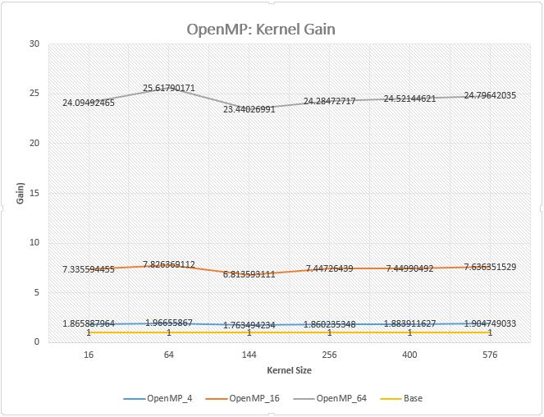

Slide 10
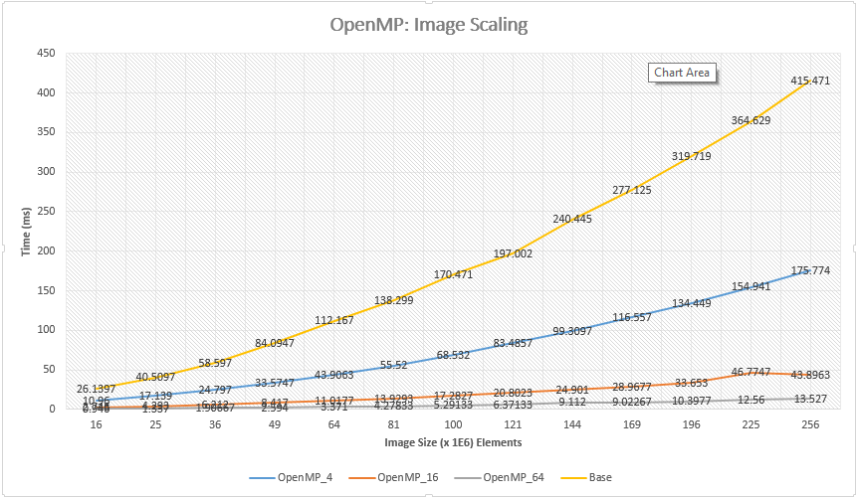
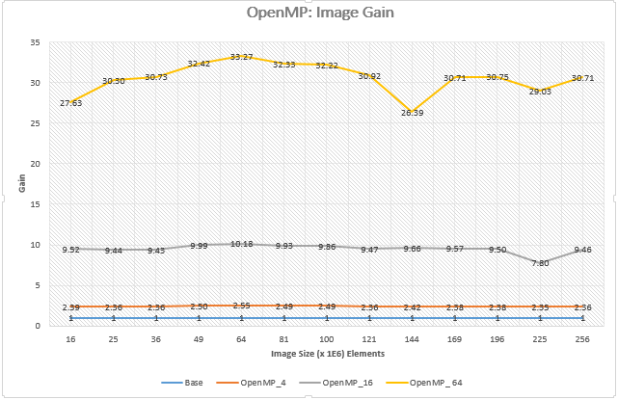

Slide 11
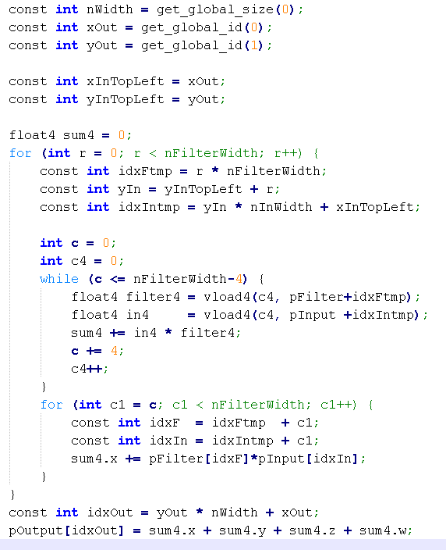
OpenCL
Similar Programming model as CUDA
Kernel stored as ASCII text string, handling kernel with wrappers.
Supports both CPU and GPU device types.
On CPU, supports vectorizations

Slide 12
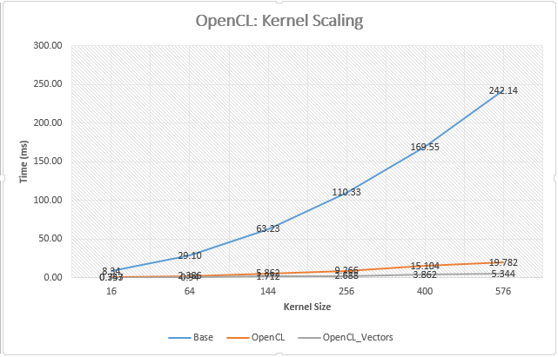
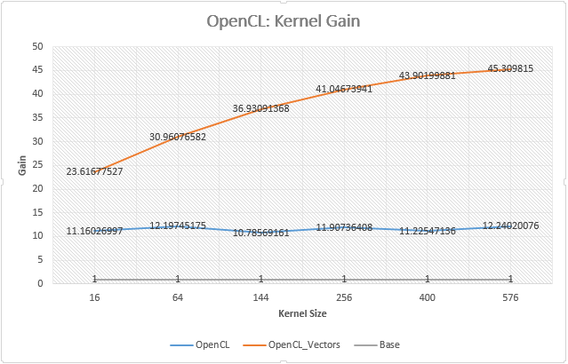

Slide 13
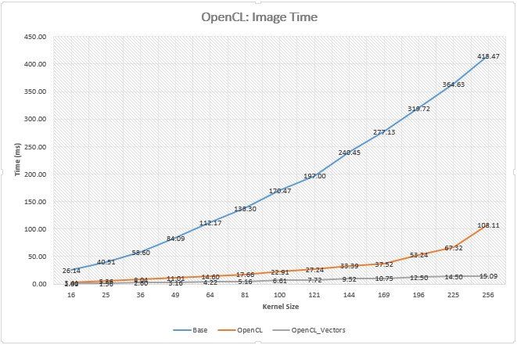
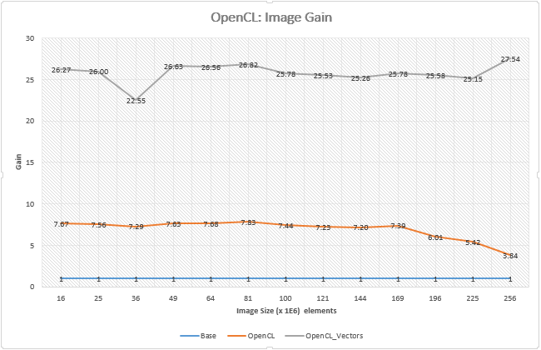

Slide 14
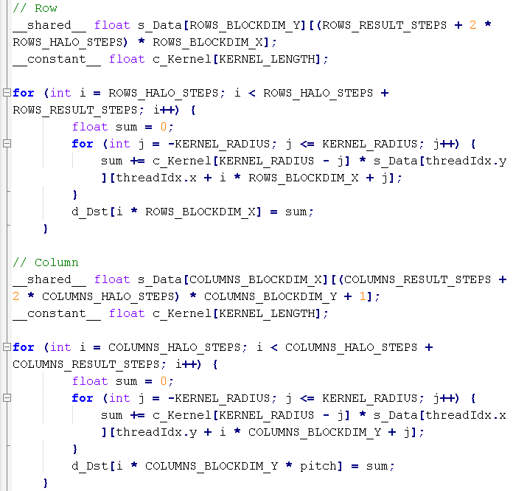
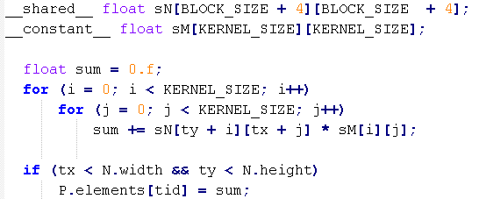
CUDA
Two types of kernels: Normal and Separable
Different memory usage patterns for CPU and GPU
Measured Inclusive time
Kernel Scaling: Increasing speedups with constant throughput

Slide 15
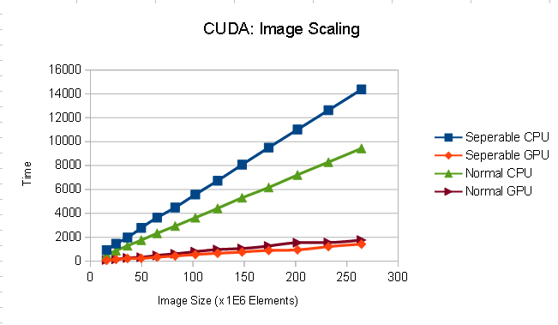
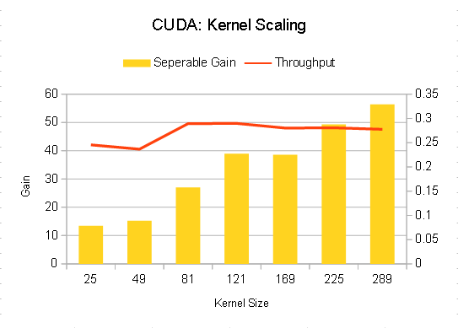
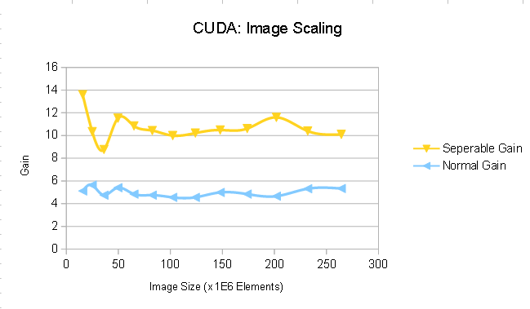

Slide 16
Thank you!

Slide 17
Backups

Slide 18
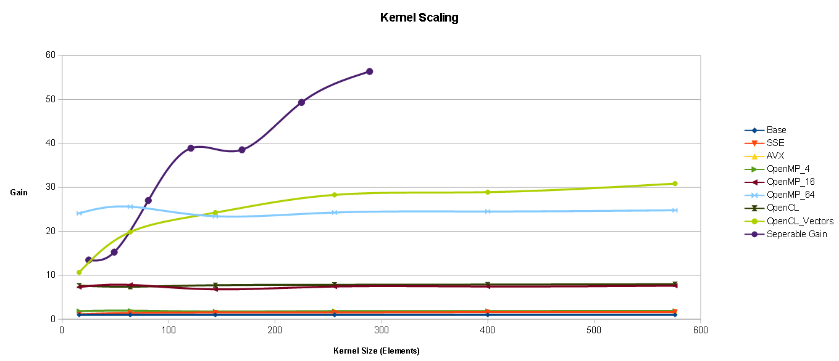

Slide 19
